Slide 1

WHAT IS MARCO ?
A Modern Day solution to Defi your investment portfolio with bonds.
Notes:
Hello and welcome, my name is [NAME] and team .Today we will be addressing the problem statement [open innovation] on Decentralized bond market.
Starting with the presentation>>>

Slide 2
Problem Statement
OPEN INNOVATION:
Decentralized Finance is a major upcoming sector.
Channel your creativity through Web 3.0 technologies and create an application solving / simplifying a task.
Building a web application for issuing BONDs in Decentralized form and verifying the authenticity.

Slide 3

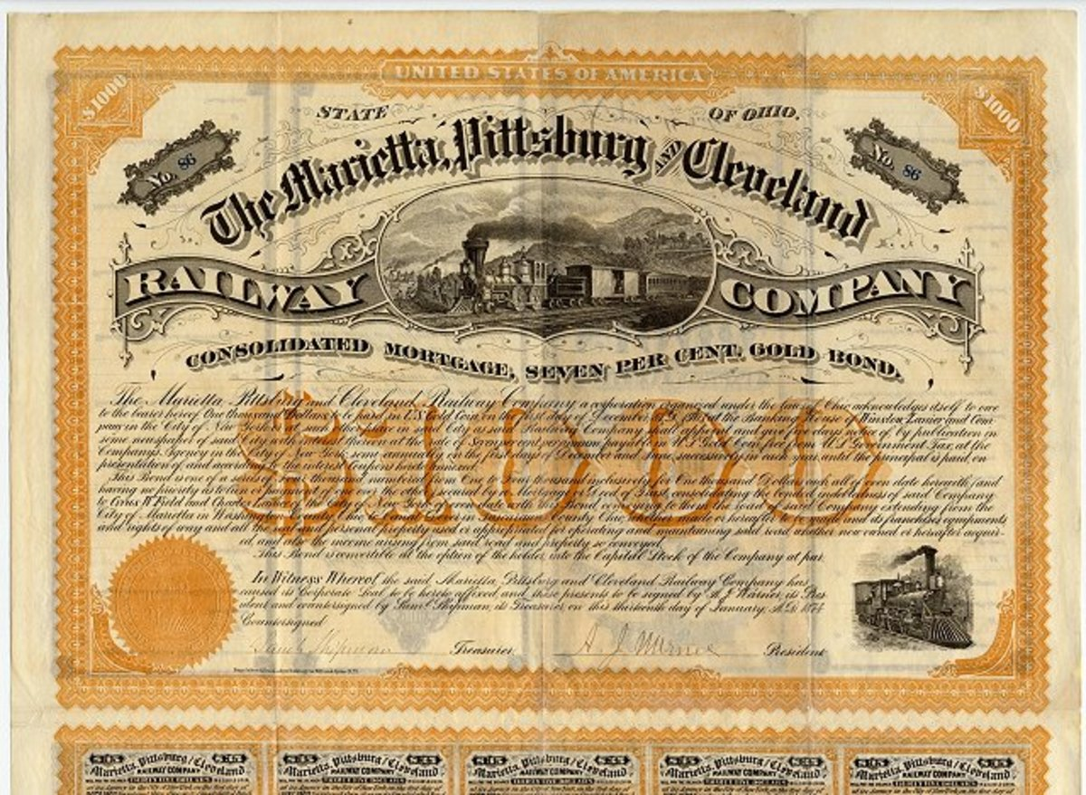
WHY TRADITIONAL BONDs LACK IN SECURITY?
A Traditional bond is a fixed income instrument that represents a loan made by an investor to a borrower , involving middleman.
But it accompanies a lot of risks including tampering ,thefts and misplacing of documents.
Notes:
I.O.U I own you
Bond prices are inversely correlated with interest rates: when rates go up, bond prices fall and vice-versa.
Bonds are units of corporate debt issued by companies and securitized as tradeable assets.
A bond is referred to as a fixed-income instrument since bonds traditionally paid a fixed interest rate (coupon) to debtholders.
Bonds have maturity dates at which point the principal amount must be paid back in full or risk default.
could be thought of as an I.O.U between the lender and borrower that includes the details of the loan and its payments.
They are used by companies, municipalities, states, and sovereign governments to finance projects and operations.
-This increases the risk of tampering of bond…
Owners of bonds are debtholders, or creditors, of the issuer.

Slide 4
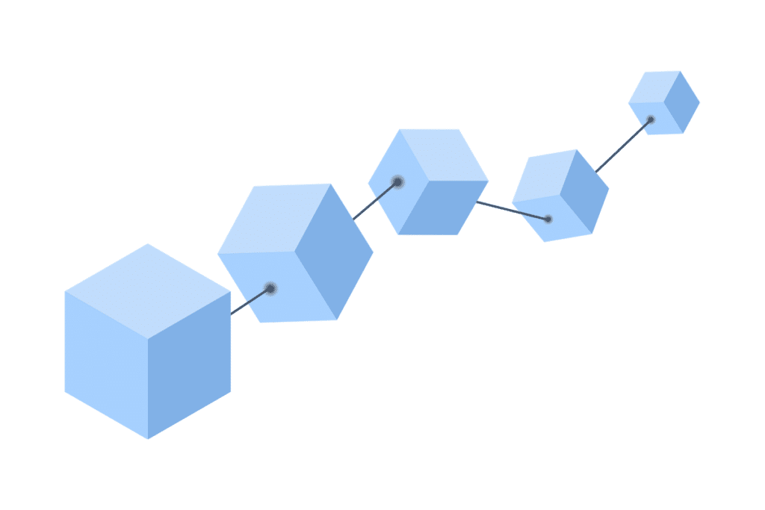
WHAT IS BLOCKCHAIN?
A Blockchain is a distributed digital ledger that stores data of any kind.
It can record information about cryptocurrency transactions, NFT ownerships or Defi smart contracts.
While any conventional database can store this sort of information, Blockchain is unique in that it is totally decentralized
It is a digital ledger of transactions that is duplicated and distributed across the entire network of computer system of blockchain
Each block in the chain contains a number of transactions, and, every time a new transaction occurs on the blockchain, a new record of that transaction is added to every participant’s ledger.
The decentralised database managed by multiple participants is known as Distributed Ledger Technology (DLT).
Blockchain is a type of DLT in which transactions are recorded with an immutable cryptographic signature called a Hash.
Data
Hash
Hash of previous block

Slide 5
Can Blockchain benefits financial industries?
In adverse conditions such as natural calamities, physical data centre are prone to data loss, whereas in blockchain as long as even a single node is in operation the data is completely safe and secured.
Blockchains can contribute to the important goals of reducing cybersecurity risk such as Malware and Ransomware attacks.
Blockchain also provides participants with enhanced transparency, making it much more difficult to corrupt blockchains through manipulative actions.
It offers multiple layer security both at network level and installed at the level of each individual participants
Blockchains are hosted on a cloud platform such as Amazon AWS, Microsoft AZURE etc.
Notes:
This means if one block in one chain was changed, it would be immediately apparent it had been tampered with. If hackers wanted to corrupt a blockchain system, they would have to change every block in the chain, across all of the distributed versions of the chain.
Blockchains such as Bitcoin and Ethereum are constantly and continually growing as blocks are being added to the chain, which significantly adds to the security of the ledger.
There have been many attempts to create digital money in the past, but they have always failed.
The prevailing issue is trust. If someone creates a new currency called the X dollar, how can we trust that they won't give themselves a million X dollars, or steal your X dollars for themselves?
Bitcoin was designed to solve this problem by using a specific type of database called a blockchain. Most normal databases, such as an SQL database, have someone in charge who can change the entries (e.g. giving themselves a million X dollars). Blockchain is different because nobody is in charge; it’s run by the people who use it. What’s more, bitcoins can’t be faked, hacked or double spent – so people that own this money can trust that it has some value.

Slide 6

History
2400BC
First known bond in history (Nippur, Mesopotamia)
1200
1693
Venice’s city-state govt. issued war bonds
USA issued first Sovereign Treasury

Slide 7
History
And still going strong!
1970s
2022
Companies were allowed to issued corporate bonds
Marco (DeFi platform)

Slide 8

Our philosophy
Mission
We promote the adoption of blockchain technologies to democratize the bond market.
Vision
We promote efficient, effective and responsive function of financial system.
Values
We values innovation,Enthusiansm and capabilities of our global blockchain community.
Notes:
Our p

Slide 9

Business Plan
Marco can issue a bond and keep its ledger on the blockchain.
Users can also verify the bond details using a unique bond ID which would be automatically generated by the platform.
Any case of dishonest conduct will revoke the credentials.
Notes:
Decentralization

Slide 10
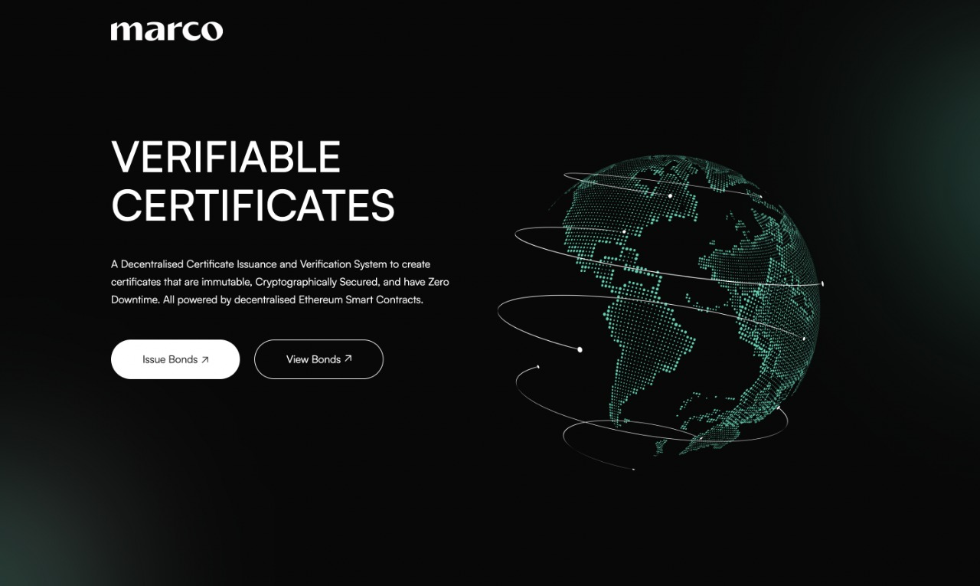
Prototype

Slide 11





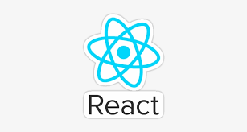

Tech Stack/Architecture
MetaMask
Infura
Deploy Contract
Front-end
Ethereum

Slide 12

Future Prospects
In addition to bond issuance and bond verifications, the platform has potential to be peer-to peer bond buying & selling marketplace.

Slide 13

The financial services industry stands to benefit tremendously from the growth of blockchain given the technology’s many financial services applications. As cyber threats to the industry continue to evolve in complexity and intensity, emerging technologies, such as permissioned blockchains, can contribute to the important goals of reducing cybersecurity risk and adequately protecting consumers’ financial information and the integrity of the global financial system. Permissioned blockchains offer significant cybersecurity capabilities, share some of the same cyber risks that affect other IT systems, and have unique characteristics, all of which merit further consideration and evaluation by governments and industry.
Conclusion
Notes:
Problem state.
Idea
Business plan
Detail on the tech stack they are using

Slide 14

Thank You!
Pranjal Paira
Aakriti Abhay Singh
Shubhangi
Raskar Varun

